Slide 1
Hospital Visit
Presented by: Mukesh Dani

Slide 2
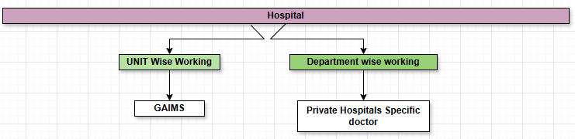
Unit Structure
Unit Head
Professor
Assistant Professor
etc.
GAIMS
Different specialties have different unit structure Ex: ENT: 2, OPTHAL: 2 , DERMA: 1, ORTHO: 3, General Surgery: 3 etc.
Medical College Establishment Guidelines To establish a medical college within a hospital, the National Medical Commission (NMC) has specific guidelines regarding the number of beds, workload of department and the corresponding number of seats for undergraduate (UG) and postgraduate (PG) courses.

Slide 3
Departments:

Slide 4
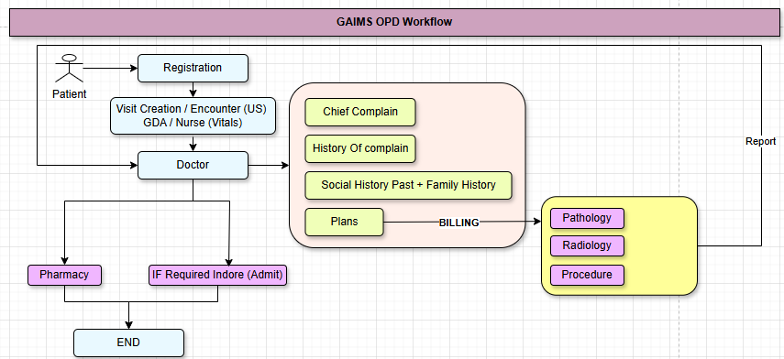
OPD Workflow:
Issues: The doctor is not entering the clinical documentation of the patient's OPD visit into the HIMS software.

Slide 5
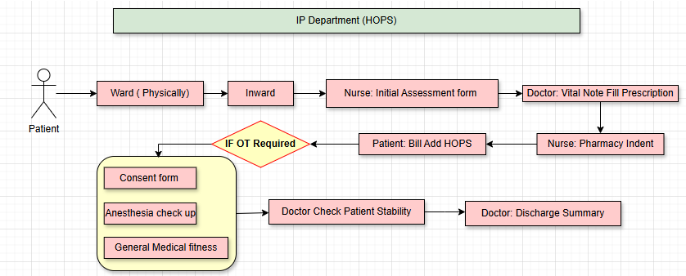
GAIMS IP Department Workflow: (HOPS)
From Details:
Demographic -> Diagnosis -> Final Diagnosis (ICD 10 International Classification of Diseases) -> Reason for Admission -> Chief Complaint -> Significant Findings-> Investigations -> Clinical Summary & Course in Hospital -> Surgery Details -> Condition on Discharge-> Medical Suggestions on Discharge -> Advice on Discharge -> Advice on Discharge
Issues: The doctor is not entering the clinical documentation of the patients into the HIMS software.

Slide 6
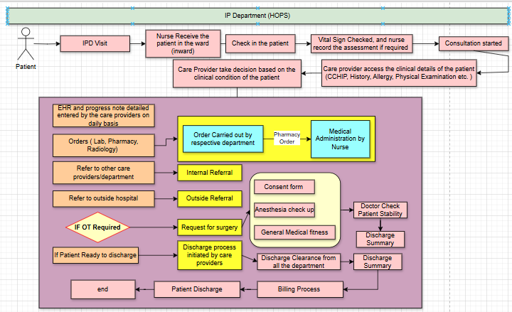

Slide 7
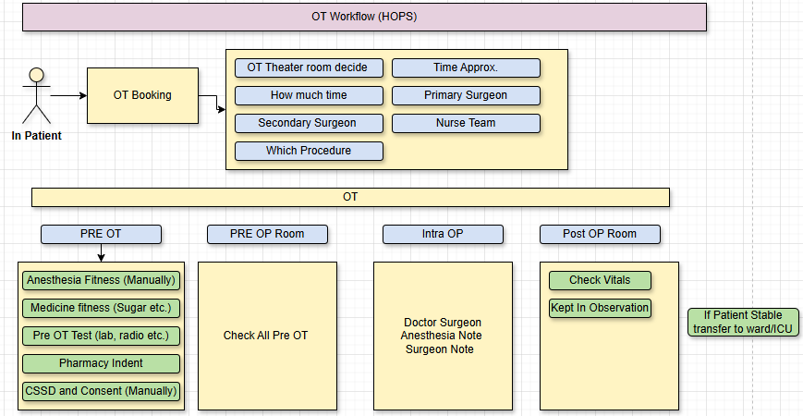
GAIMS OT Workflow: HOPS
Issues: The doctor is not entering the clinical documentation of the patients into the HIMS software.

Slide 8
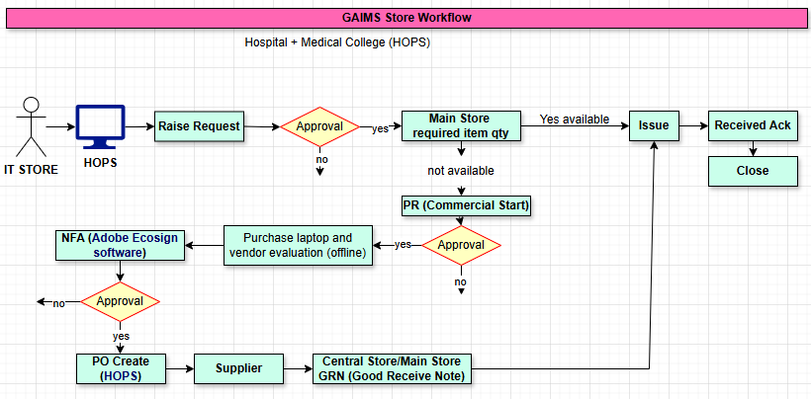
GAIMS Store Workflow:
Hospital + Medical College (HOPS & Adobe Ecosign)
Issues: No Issues as of now.

Slide 9
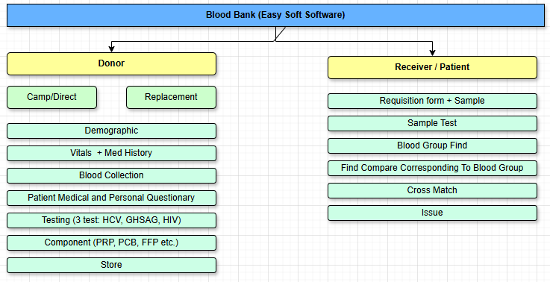
GAIMS Blood Bank Workflow:
Easy Soft Software
Issues:
HIMS and Easy Software not integrated

Slide 10
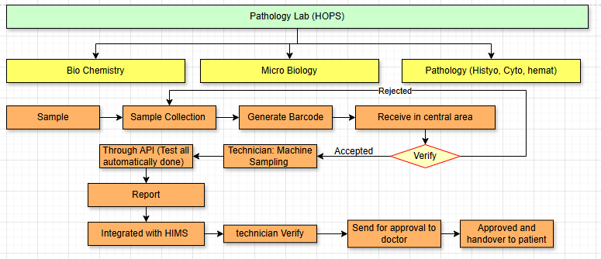
GAIMS Pathology Lab Working: HOPS
Issues: 100% Perfect

Slide 11
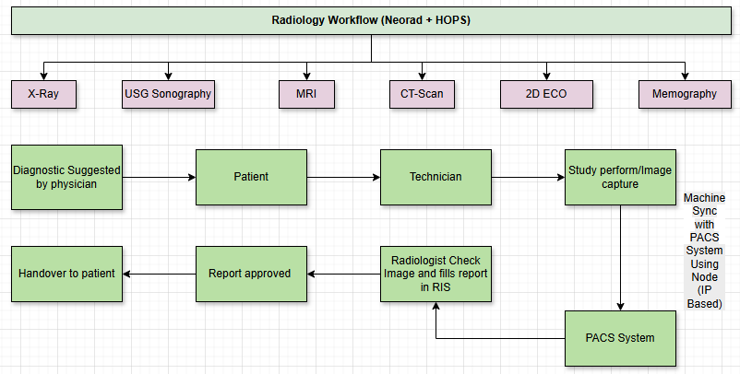
GAIMS Radiology Workflow: Neorad + HOPS
Issues: Integration is Pending between HIMS and PACS System

Slide 12
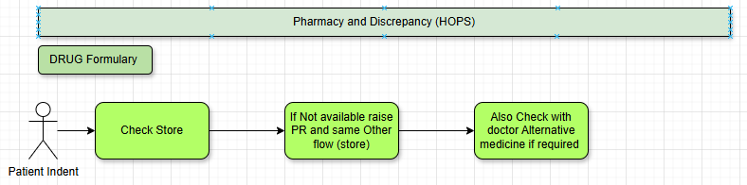
GAIMS Pharmacy and Discrepancy (HOPS)

Slide 13
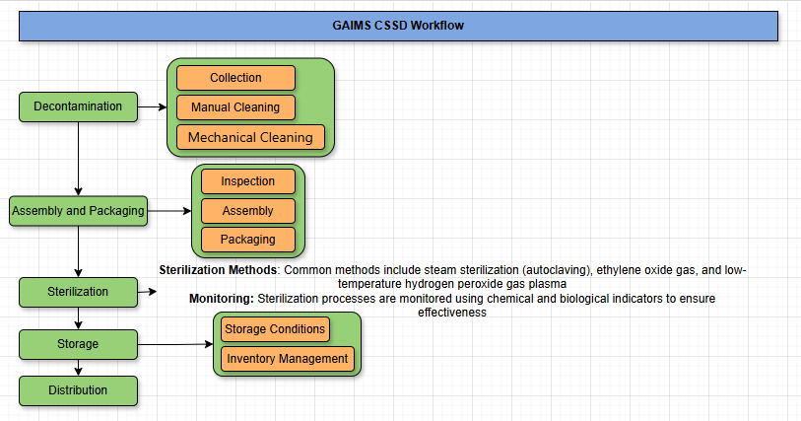
GAIMS CSSD (Central Sterile Supply Department) Workflow:

Slide 14
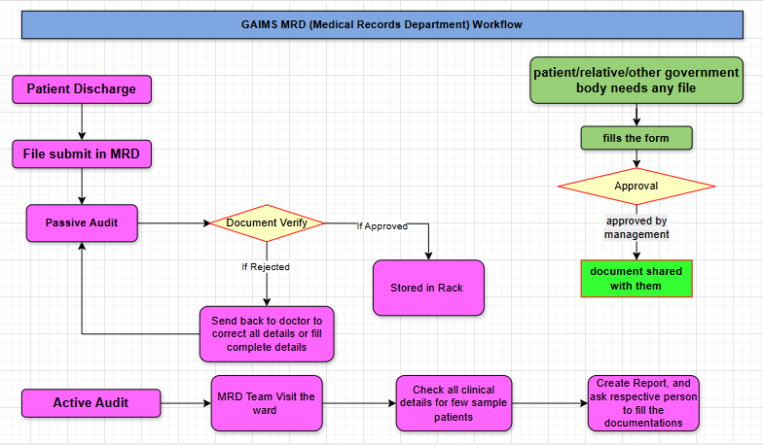
GAIMS MRD (Medical Records Department) Workflow:

Slide 15


Thank You

